Slide 1
Individual homework semantic tableaux method
Dan Radu-anton
912

Slide 2
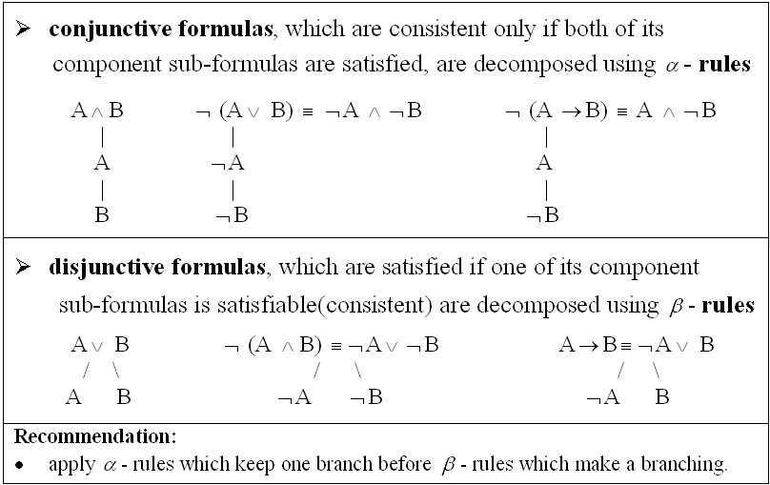
Theoretical results Basics and decomposition rules
The semantic tableaux method is a semantic proof method for propositional/predicate logic.
It is also considered a refutation proof method, not a direct proof method.
Conjunctive formulas, which are consistent only if both of its component sub-formulas are satisfied, are decomposed using α-rule. ​
Disjunctive formulas, which are satisfied if one of its component sub-formulas is satisfiable (consistent) are decomposed using β-rules.​
It is recommended that the α-rules are applied before the β-rules, so the tableaux contains a large common branch and then multiple separated branches.

Slide 3
Theoretical results Construction of a semantic tableaux
To a propositional formula U we can associate a semantic tableaux (binary tree with formulas as nodes).
Steps for the construction of a semantic tableaux:
The root of the tree is labeled with the initial formula
Every branch of the tree which contains a formula will be extended with a subtree according to the decomposition rule specific to its class
The extension of a branch stops in the following cases:
If that branch contains a formula and its negation, the branch is marked as closed using the symbol ⨂
If all the formulas on that branch are already decomposed or if by decomposing the formulas which are not decomposed yet, no new formulas are obtained

Slide 4
Theoretical results Definitions
A branch of a semantic tableaux is called closed (⨂) if it contains a formula and its negation, otherwise the branch is called open (⊙)
A branch is called complete if it is closed or all the formulas on that branch are already decomposed
A semantic tableaux is called closed if all its branches are closed
If a semantic tableaux has at least one open branch, the tableaux is called open
A semantic tableaux is called complete if all its branches are complete
Remarks:
A closed branch symbolizes inconsistency among the formulas on that branch
An inconsistent formula has associated a closed semantic tableaux
The set of formulas belonging to a complete and open branch is consistent, meaning that it has a model
A consistent formula has associated a complete and open semantic tableaux

Slide 5
Theoretical results Theorems
THEOREM 1: Soundness and completeness of the semantic tableaux method
A propositional/predicate formula U is a tautology if and only if ¬U has a closed semantic tableaux.
THEOREM 2:
Let U1, U2, … , Un, V be propositional/predicate formulas.
U1, U2, … , Un |= V if and only if there is a closed semantic tableau associated to the formula:
U1^U2^…^Un^ ¬V

Slide 6
Solving the exercise Figuring out what we need to do
Using the semantic tableaux method, decide whether the following logical consequences hold or not. If a logical consequence does not hold find an anti-model of it.
¬p->(¬q->r), rvq |= (¬p->q)vr
By using theorem 2, we get:
U1 = ¬p->(¬q->r)
U2 = rvq
V = (¬p->q)vr
In order for the logical consequences to hold, U1^U2^¬V must have a closed semantic tableaux.

Slide 7
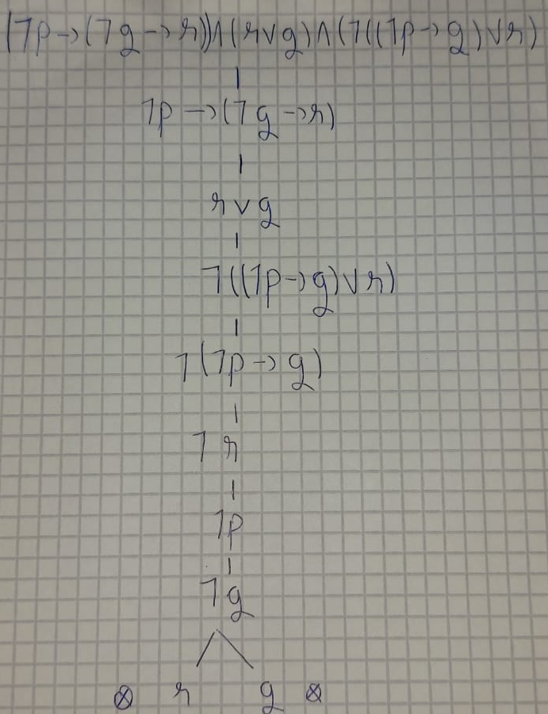
Solving the exercise Semantic tableaux construction
U = (¬p->(¬q->r)) /\ (rvq) /\ (¬ ((¬p->q)vr))
1. α-rule for the 2 main conjunctions of U 3. ¬ (¬p->q) transforms into:
We got: ¬p
(¬p->(¬q->r)) |
| ¬q
(rvq)
| 4. We break the disjunction (rvq) up
(¬ ((¬p->q)vr)) and we get 2 closed branches.
Therefore, the semantic tableaux is
2. We further break ¬ ((¬p->q)vr) into: closed.
¬ (¬p->q)
|
¬r

Slide 8
Conclusion
Because U = U1^U2^¬V has a closed semantic tableaux it means that the logical consequences hold, so:
U1= ¬p->(¬q->r)
U2 = rvq
V = (¬p->q)vr)
U = U1^U2^¬V
U = (¬p->(¬q->r)) /\ (rvq) /\ (¬ ((¬p->q)vr)), U has a closed semantic tableaux
U1, U2 |= V
¬p->(¬q->r), rvq |= (¬p->q)vr

Slide 9
Thank you for your attention!

